Slide 1
Software Engineering
(CSI 321)
Risk Management

Slide 2
Risk Management
Risk management is one of the main jobs of Project Manager.
Risk management is a set of actions that helps the project manager plan an approach to deal with uncertain occurrences.
It involves anticipating risks that might affect the project schedule or the quality of the software being developed and taking actions to avoid these risks.
Risk management is an emerging area that aims to address the problem of identifying and managing the risks associated with a software project.

Slide 3
Risk Management
Risk in a project is the possibility that the defined goals are not met. It is the inability to achieve objectives within defined cost, schedule, and technical constraints.
Most projects have risks, especially the big projects.
Risk management is the area that tries to ensure that the impact of risks is minimal on –
  Cost
  Quality
  Schedule

Slide 4
Why is Risk Management important?
History of software development is full of major & minor failures (Because risks were not identified & managed properly).
  Projects run over budget
  Behind schedule
  Some abandoned midway
Any project can encounter uncertainties in the form of increased costs, schedule delays, and diminished qualities. Unless tackled, these uncertainties can lead to major project disasters.
Software is a difficult undertaking. Lots of things can go wrong. Understanding the risks and taking proactive measures to avoid or manage them –is a key element of good software project management.

Slide 5
Risk Management
What can go wrong?
What is the likelihood?
What will the damage be?
What can we do about it?

Slide 6
Risk Management Process
What are the steps in Risk Management Process?, or
What are the major activities/tasks of a project manager in risk management?
Risk Identification –possible risks are identified
Risk Analysis –risks are analyzed to determine the likelihood and the damage/consequences. Risks are ranked by probability & impact.
Risk Planning –A plan is developed to manage the risks with high probability & high impact.
Risk Monitoring –Risk is constantly assessed & plans for risk mitigation are revised.

Slide 7
Characterizing Risk
Risk concerns the future happenings
  What risks might cause software project to go awry? What can we do today to avoid problems tomorrow?
Risk involves change
  How will changes affect timeliness & overall success?
  What aspects of the problem domain and solution are unstable?
Risk involves choice & uncertainty
  What methods & tools should we use? How many people should be involved? How much emphasis on quality is “enough”? We often make decisions based on incomplete information.
RISK, like DEATH, is one of the few certainties of life.

Slide 8
Risk Strategies : Reactive vs. Proactive
Reactive Risk Management:
  Laughingly called “Indiana Jones school of risk management”
  Risk management ==> Crisis management (“fire-fighting mode”)
  Project team reacts to risks when they occur
  Software team does nothing about risks until something goes wrong, then the team flies into action in an attempt to correct the problem rapidly(this is called “fire-fighting mode”). When this fails, “crisis management” takes over and the project is in real jeopardy.

Slide 9
Risk Strategies : Reactive vs. Proactive
Proactive Risk Management:
  A considerably more intelligent strategy for risk management
  Identify potential risks in advance
  Assess probability and impact
  Prioritize the risks by importance
  Establish explicit risk management plan
  But “Risk is unavoidable”( not all risks can be avoided), so contingency plan is developed

Slide 10
Software Risks
Software risk always involves two characteristics –
Uncertainty –the risk may or may not happen; there are no 100% probable risks.
Loss –If the risk becomes a reality, unwanted consequences or losses will occur.

Slide 11
Software Risks
When risks are analyzed, it is important to –
  Quantify the level of uncertainty
  The degree of loss associated with each risk
  Consider different categories of risks

Slide 12
Categories of Risks
What are the categories of risks encountered as software is built?
  Project risks
  Product risks
  Technical risks
  Business risks
  Known risks
  Predictable risks
  Unpredictable risks
Note that these risk types may overlap.

Slide 13
Project Risks
Project risks threaten the project plan. If risks become real, then
  Project schedule will slip
  Costs will increase
Project risks affect the project schedule or resources.
Project risks identify potential budgetary, schedule, personnel, resource, stakeholder and requirements problems and their impact on a software project.
Examples: Experienced staff will leave the project before it is finished, Essential hardware for the project will not be delivered on time, There will be a change of organizational management with different priorities.

Slide 14
Product Risks
Product risks are risks that affect the quality or performance of the software being developed.
An example might be the failure of a purchased component to perform as expected.
Other examples – Size underestimate, Requirement change, CASE tool underperformance

Slide 15
Technical Risks
Threaten quality and timeliness of the software to be produced. If a technical risk becomes a reality, implementation may become difficult/impossible.
Technical risks identify potential design, implementation, interface, verification and maintenance problems.
Other risk factors: specification ambiguity, technical uncertainty, technical obsolescence, “leading-edge” technology.

Slide 16
Technical Risks
Technical risks occur because the problem is harder to solve than we thought it would be.
  Is the technology new to you?
  New algorithms ?
  Interface with new/unproven HW/SW/DB?
  Specialized user interface?
  New analysis, design, testing methods?
  Unconventional development methods?
  Excessive performance constraints?
  Customer uncertain about feasibility?

Slide 17
Business Risks
Business risks threaten the viability of the software to be built.
Business risks often jeopardize the project or the product.
Business risks affect the organization development or procuring the software.
Top five business risks –
  No market for product (market risk)
  Product no longer fits in the business plan (strategic risk)
  Sales force doesn’t know how to sell the product (sales risk)
  Loss of management support (management risk)
  Losing budgetary or personnel commitment (budget risk)

Slide 18
Known Risks
Uncovered after careful evaluation of the project plan, the business & technical environment in which the project is being developed and other reliable information sources.
Examples
  Unrealistic delivery date
  Lack of documented requirements
  Lack of software scope
  Poor development environment

Slide 19
Predictable Risks
Predictable risks are extrapolated from past project experience.
Examples
  Staff turnover
  Poor customer communication

Slide 20
Unpredictable Risks
Extremely difficult to identify in advance
They can and do occur

Slide 21
Seven Principles Of Risk Management
Maintain a global perspective—View software risks within the context of system and the business problem
Take a forward-looking view—Think about the risks that may arise in the future; Establish contingency plans so that future events are manageable
Encourage open communication—If someone states a potential risk, don’t discount it.
Integrate—A consideration of risk must be integrated into the software process.

Slide 22
Seven Principles Of Risk Management
5) Emphasize a continuous process—The team must be vigilant throughout the software process, modifying identified risks as more information is known and adding new ones as better insight is achieved.
6) Develop a shared product vision—If all stakeholders share the same vision of the software, it likely that better risk identification and assessment will occur.
7) Encourage teamwork—The talents, skills and knowledge of all stakeholder should be pooled when risk management activities are conducted.

Slide 23
Risk Management Paradigm
Control
Track
RISK
Identify
Plan
Analyze

Slide 24
Risk Identification
Risk identification is a systematic attempt to specify threats to the project plan ( estimates, schedule, resource loading etc.)
By identifying known & predictable risks, the project manager takes a first step toward –
  avoiding them when possible
  controlling them when necessary

Slide 25
Risk Identification
There are two distinct types of risks for each of the categories we discussed
Generic risks – are a potential threat to every software project.
Product-specific risks
  Can be identified only by those with a clear understanding of the technology, the people, and the environment that is specific to the software to be built
  To identify product-specific risks, the project plan & statement of scope are examined

Slide 26
Risk Identification Method
One method for identifying risks is to create a risk item checklist.
The checklist can be used for risk identification and focuses on some subset of known & predictable risks in the following generic subcategories:
  Product size—Risks associated with the overall size of the software to be built or modified.
  Business impact—Risks associated with constraints imposed by management or the marketplace.
  Customer characteristics—Risks associated with the sophistication of the customer and the developer's ability to communicate with the customer in a timely manner.

Slide 27
Risk Identification
4) Process definition—Risks associated with the degree to which the software process has been defined and is followed by the development organization.
5) Development environment—Risks associated with the availability and quality of the tools to be used to build the product.
6) Technology to be built—Risks associated with the complexity of the system to be built and the "newness" of the technology that is packaged by the system.
7) Staff size and experience—Risks associated with the overall technical and project experience of the software engineers who will do the work.

Slide 28
Assessing Overall Project Risk-I
Is the current software project at serious risk?
Have top software and customer managers formally committed to support the project?
Are end-users enthusiastically committed to the project and the product to be built?
Are requirements fully understood by the software engineering team and their customers?
Have customers been involved fully in the definition of requirements?
Do end-users have realistic expectations?

Slide 29
Assessing Overall Project Risk-II
Is project scope stable?
Does the software engineering team have the right mix of skills?
Are project requirements stable?
Does the project team have experience with the technology to be implemented?
Is the number of people on the project team adequate to do the job?
Do all customer/user constituencies agree on the importance of the project and on the requirements for the product to be built?

Slide 30
Risk Components & Impacts
Performance risk—the degree of uncertainty that the product will meet its requirements and be fit for its intended use.
Cost risk—the degree of uncertainty that the project budget will be maintained.
Support risk—the degree of uncertainty that the resultant software will be easy to correct, adapt, and enhance.
Schedule risk—the degree of uncertainty that the project schedule will be maintained and that the product will be delivered on time.
Impact Category: Negligible, Marginal, Critical, Catastrophic

Slide 31
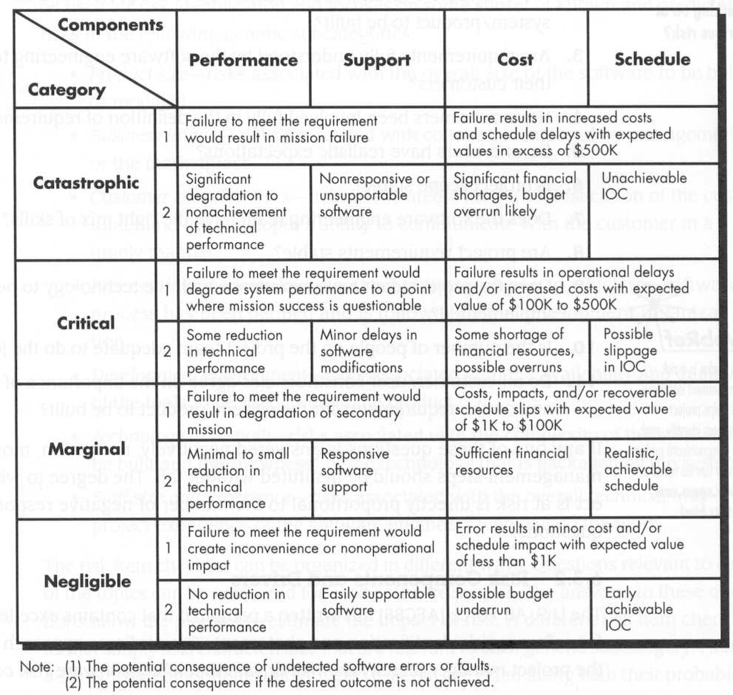
Impact Assessment

Slide 32
Risk Estimation/Projection
Risk projection, also called risk estimation, attempts to rate each risk in two ways
  The likelihood or probability that the risk is real
  The consequences of the problems associated with the risk, should it occur.

Slide 33
Risk Estimation/Projection
There are four risk projection steps:
  Establish a scale that reflects the perceived likelihood of a risk
  Delineate the consequences of the risk
  Estimate the impact of the risk on the project and the product
  Note the overall accuracy of the risk projection (to avoid misunderstandings).

Slide 34
Developing a Risk Table
A Risk Table provides a project manager with a simple technique for risk projection
  Estimate the probability of occurrence
  Estimate the impact on the project on a scale of 1 to 4, where
    4 = Negligible/low impact on project success
    3 = Marginal impact on project success
    2 = Critical impact on project success
    1 = Catastrophic impact on project success
  Sort the table by probability and impact

Slide 35
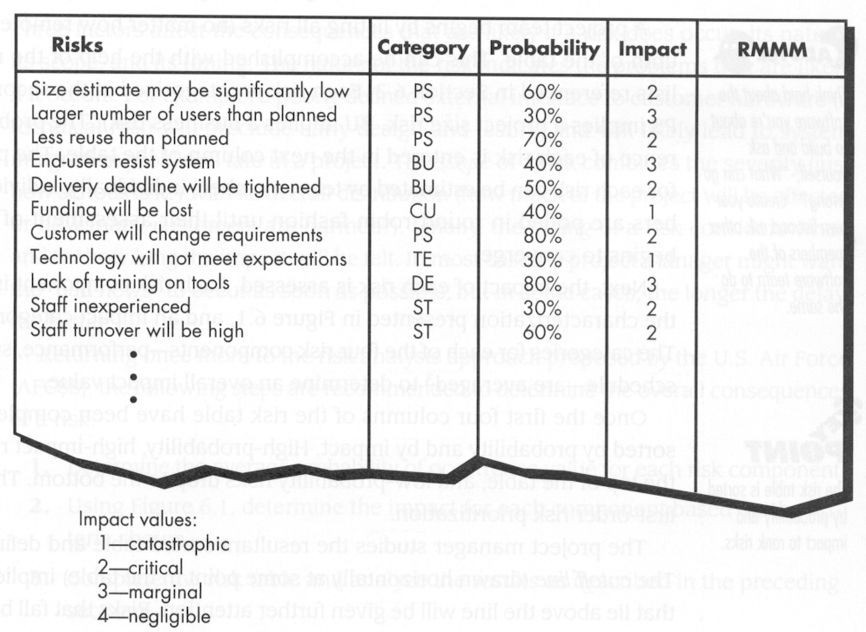
Developing a Risk Table
A Risk Table provides a project manager
with a simple technique for risk projection
PS – project size risk
BU – business risk

Slide 36
Assessing Risk Impact
How do we assess the consequences of a risk?
Three factors affect the consequences that are likely if a risk does occur:
  It’s nature-indicates the problems that are likely
  Scope- Severity & its overall distribution
  Timing- When & for how long the impact will be felt

Slide 37
Risk Exposure (Impact)
The overall risk exposure, RE, is determined using the following relationship :
RE = P x C , where
  P is the probability of occurrence for a risk
  C is the cost to the project should the risk occur
Risk exposure can be computed for each risk in the Risk Table, once an estimate of the cost of the risk is made.
Total risk exposure for all risks can provide a means for adjusting the final cost estimate for a project.
Note: If RE > 50% of Project Cost, viability of the project must be reevaluated.

Slide 38
Risk Exposure: An Example
Risk identification. Only 70 percent of the software components scheduled for reuse will, in fact, be integrated into the application. The remaining functionality will have to be custom developed.
Risk probability. 80% (likely).
Risk impact. 60 reusable software components were planned. If only 70 percent can be used, 18 components would have to be developed from scratch (in addition to other custom software that has been scheduled for development). Since the average component is 100 LOC and local data indicate that the software engineering cost for each LOC is $14.00,
The overall cost (impact) to develop the components would be,
18 x 100 x 14 = $25,200
Risk exposure. RE = 0.80 x 25,200 ~ $20,200.

Slide 39
Risk Mitigation, Monitoring, and Management
Mitigation—How can we avoid the risk?
Monitoring—What factors can we track that will enable us to determine if the risk is becoming more or less likely?
Management—What contingency plans do we have if the risk becomes a reality?

Slide 40
The RMMM plan
Risk management strategy can be included in the software project plan or the risk management steps can be organized into a separate RMMM plan.
The RMMM plan (Risk Mitigation, Monitoring and Management plan):
  Documents all work performed as part of risk analysis
  Used by Project Manager as part of the overall project plan

Slide 41
The RMMM plan
Risk mitigation
  Problem avoidance activity
  Proactive planning for risk avoidance

Slide 42
The RMMM plan
Risk monitoring
Project tracking activity with three primary objectives –
    Assessing whether predicted risks occur or not
    Ensuring risk aversion steps are being properly applied
    Collect information for future risk analysis
Determining what risk(s) caused which problems throughout the project

Slide 43
The RMMM plan
It is important to note that RMMM steps incur additional project cost.
Project planner performs a classic cost/benefit analysis.
Adapt Pareto rule(80–20 rule) to software risks:
  80% of the overall project risk can be accounted for by only 20% of the identified risks.
  Work performed during earlier risk analysis steps will help the planner to determine which of the risks reside in that 20%
The RMMM Plan needs to be tracked & updated regularly.

Slide 44
Risk Information Sheets
RIS (Risk Information Sheet)
Instead of developing a formal RMMM plan, some software teams use RIS.
In RIS, each risk is documented individually.
In most cases, the RIS is maintained using a database system.
RIS components:
  risk id, date, probability, impact, description
  refinement, mitigation/monitoring
  management/contingency plan/trigger
  current status
  originator, assigned staff member

Slide 45
Risk Management
“If you know the enemy and know yourself, You need NOT fear the result of a hundred Battles.”
For the software project manager, The enemy is RISK!
Sun Tzu ( Chinese General)

